Slide 1

android.gesture
By: Alan Boutilier and Avery Briggs

Slide 2
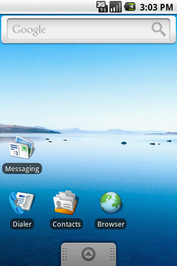
Contents
Overview
Why we chose this API
How do gestures work
Touch events
Package classes
Pros and Cons
Our app
References

Slide 3
Gestures in Android Overview
Added in API Level 4 or Android 1.6 (Donut). Released September 15th, 2009
With today’s boom smartphone usage, gesture control has become a huge point of interest for mobile devs to create interactive and memorable apps..
Provides the user with many different ways to interact with their phone.

Slide 4
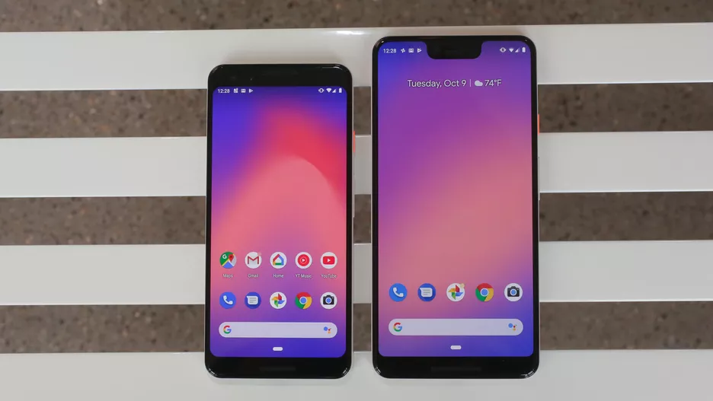
Why we chose this API?
Google Pixel 3 Series
We chose the android.gesture package because we wanted to create a new way of interacting with your device. Many people are unaware of the ease of use simple gestures can provide, and we wanted to create a gesture that would be easy to remember and use on anyone’s device. Gestures have become very important in today's smartphones with the boom of larger displays and less buttons on the device.

Slide 5
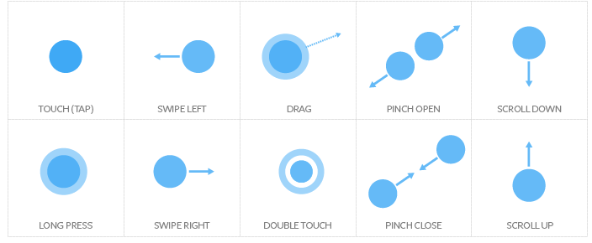
Touch events
Every time the screen is touched, a TouchEvent is triggered within the phone.
Drag
Tap
Double-tap
Multi-touch
Long press
Flick
Swipe

Slide 6
android.gesture.Gesture
A gesture is a hand-drawn shape on a touch screen. It can have one or multiple strokes. Each stroke is a sequence of timed points. A user-defined gesture can be recognized by a GestureLibrary.
Getters:
Setters: public void addStroke(GestureStroke stroke)

Slide 7
GestureLibraries

Slide 8
GestureLibrary

Slide 9
GestureOverlayView

Slide 10
GesturePoint

Slide 11
GestureStore

Slide 12
GestureStroke

Slide 13
GestureUtils

Slide 14
OrientedBoundBox

Slide 15
Prediction

Slide 16
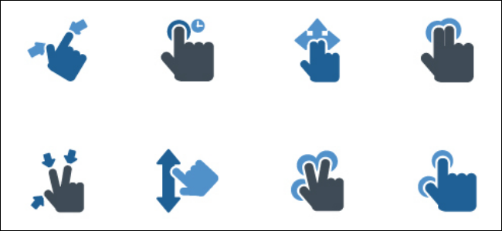
Why Gestures
More ways of providing input
Seamless Interaction
Less clutter
Ease of use

Slide 17
The Downside of Gestures
Trying to make gestures feel natural can be difficult
Time consuming to program.
Very old documentation

Slide 18
Using the android.gesture API

Slide 19
Our App

Slide 20
References
https://en.wikipedia.org/wiki/Android_version_history#Android_1.6_Donut_(API_4)
https://www.slideshare.net/chasc/multi-touch-and-gesture-event-interface-and-types
https://developer.android.com/reference/android/gesture/package-summary.html

